Slide 1







2017
2017
Build an immutable application infrastructure with Nano Server, PowerShell DSC, and the
release pipeline
PowerShell Uncensored
Ravikanth Chaganti
Jason Yoder & Jaap Brasser

Slide 2
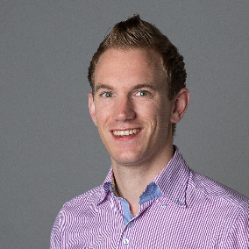

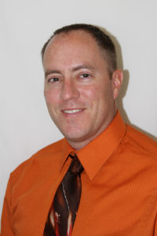
About_Jaap
About_RoyalHighness_Jason
@ JasonYoder_MCT
DuPSUG
Blogging
Slack
Reddit
GitHub
MCSE since Windows NT4
Bachelors degree in Computer Science
Microsoft Certified Trainer
SAPIEN Technologies PowerShell MVP
Technical Reviewer for Microsoft’s official PowerShell training
Author of Advanced Windows PowerShell Scripting video training
@Jaap_Brasser
JaapBrasser.com/about

Slide 3
2018
psconf.eu 2018
scheduled to be in the week of
April 16-20, 2018
details on www.psconf.eu as they become available

